Slide 1
VideoSync

Slide 2
VideoSync

Slide 3
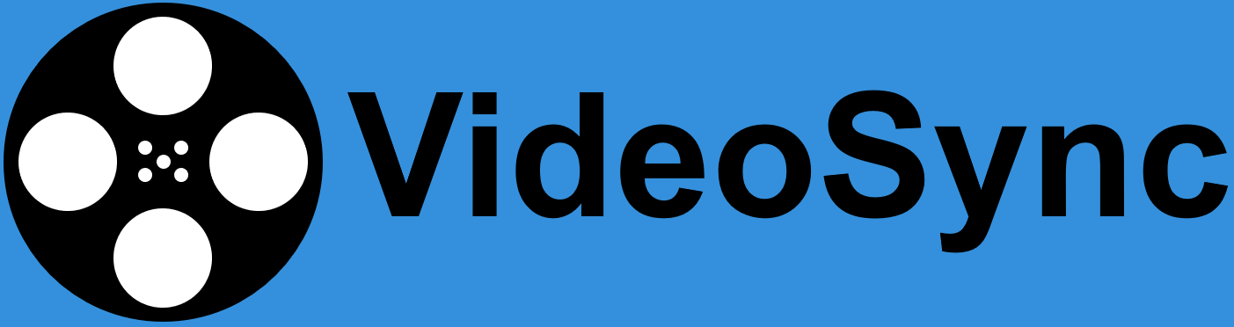

Slide 4
